Slide 1
more for loops.
Week 6 | Lecture 2 (6.2)

Slide 2
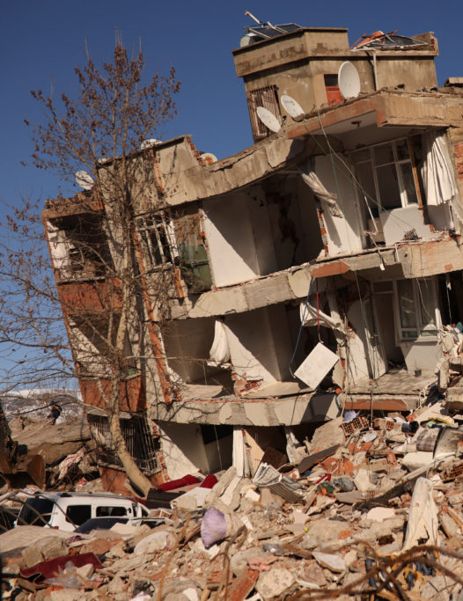
Disaster Relief
Turkish students at UofT are collecting donations of items to assist relief efforts.
Location to donate your items:
Lassonde Mining Building Room 225 (MIE Common Room).
Items:
Torches, hygiene products, hand warmers, sleeping bags, and winter clothing with tags on or in new condition.

Slide 3
This Week’s Content
Lecture 6.1
for loops
Reading: 9.3, 9.4
Lecture 6.2
for loops on indices, nested loops
Reading: 9.5 – 9.9
Lecture 6.3
Design Problem: Wordle

Slide 4
for loops
name = ‘Sebastian’
for character in name:
print(character)
Output:
S
e
b
a
s
t
i
a
n
A for loop starts with the keyword for.

Slide 5
for loops
name = ‘Sebastian’
for character in name:
print(character)
for item1, item2 in iterable:
do something.
Next, we provide the name of one of more variables.
We have called the variable character, but you can call it whatever you like as long as it follows rules for naming a variable.

Slide 6
for loops
name = ‘Sebastian’
for character in name:
print(character)
Output:
S
e
b
a
s
t
i
a
n
Our variable character will be bound to each of the items in the sequence in turn.

Slide 7
for loops
name = ‘Sebastian’
for character in name:
print(character)
Output:
S
e
b
a
s
t
i
a
n
Specify what the values are in.
What is the iterable?
An iterable is an object that can be iterated over.
Strings are iterable (we know these from last week).
Lists (next week) are iterable.

Slide 8
for loops
name = ‘Sebastian’
for character in name:
print(character)
Output:
S
e
b
a
s
t
i
a
n
As with the while loop, the for loop statement ends with a colon.
This is how Python knows you are going to create a new block of code.

Slide 9
for loops
name = ‘Sebastian’
for character in name:
print(character)
Output:
S
e
b
a
s
t
i
a
n
Indenting four spaces tells Python what lines of code are in that block you want to repeated.
Indent

Slide 10
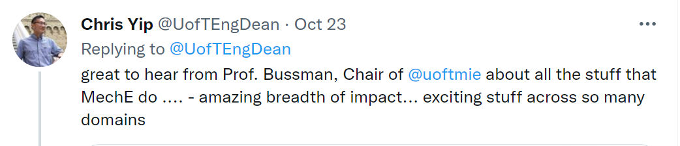
Breakout Session 1
We want to do some analysis of Dean Yip’s Tweets.
Before we can do this, we’ll need to make the tweet all lower case and replace all the punctuations with white space.
‘impact... Exciting’ → ‘impact exciting‘
Open your notebook
Click Link:
1. Breakout Session 1

Slide 11
Today’s Content
Looping through indices with a for loop.
Nested for loops.

Slide 12
Looping Through Indices
Last lecture we saw that we can use while loops to loop over the indices of a string.
Then we saw that a for-loop requires less code but it iterates over the values, not the indices.
while
for
i = 0
while i < len(chrome_4):
print(i, chrome_4[i])
i += 1
for character in chrome_4:
print(character)

Slide 13
Looping Through Indices
Can we use a for loop to loop over indices?
while
for
i = 0
while i < len(chrome_4):
print(i, chrome_4[i])
i += 1
for character in chrome_4:
print(character)

Slide 14
Looping on a range()
Python has a built-in function called range() that can be used to generate a sequence of numbers. The general syntax of range is as follows:
Similar to the string slicing syntax:
The stop value is not included in the sequence of numbers generated.
Can omit start and step which will result in default values being used. range(n) → range(0, n, 1)
range(start, stop, step)

Slide 15
Looping on a range()
range() is typically used in a for loop to iterate over a sequence of numbers.
range() is an iterable.
Open your notebook
Click Link:
2. Using range()
This thing has to be an iterable.
for i in range(5):
print(i)

Slide 16
Example 1
Add up all the even numbers between 1 and 100 using a for loop and range().
2+4+…..+96+98+100
Open your notebook
Click Link:
3. Example 1

Slide 17
Breakout Session 2
Write a function that returns the number of times that a character and the next character are the same.
If you have a bug in a loop, with probability ~1 its an off-by-one index error.
Open your notebook
Click Link:
4. Breakout Session 2
count_adjacent_repeats('abccdeffggh’)
>>> 3

Slide 18
Nested for Loops
for item in iterable:
do something.
The bodies of loops can contain any statement, including other loops!
When this occurs, it is known as a nested loop.
for i in range(10, 13):
for j in range(1, 5):
print(i, j)
Output
10, 1
10, 2
10, 3
…

Slide 19
Nested for Loops
The bodies of loops can contain any statement, including other loops!
When this occurs, it is known as a nested loop.
Open your notebook
Click Link:
5. Nested for Loops

Slide 20

Turtles
Turtle is a pre-installed Python library that enables users to create pictures and shapes by providing them with a virtual canvas.
Open your notebook
Click Link:
6. Turtles

Slide 21
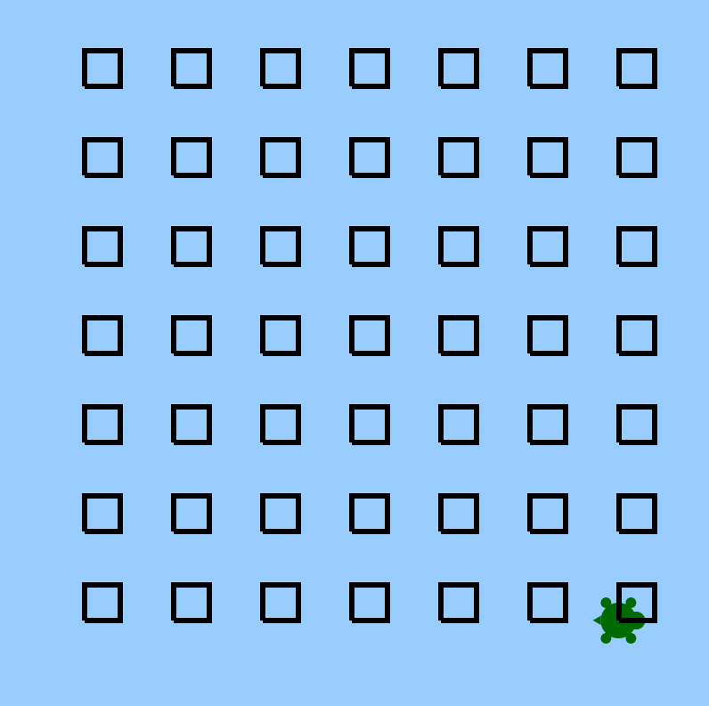
Draw A Grid
Use Turtle and nested for loops to draw a grid.
Open your notebook
Click Link:
7. Grid

Slide 22
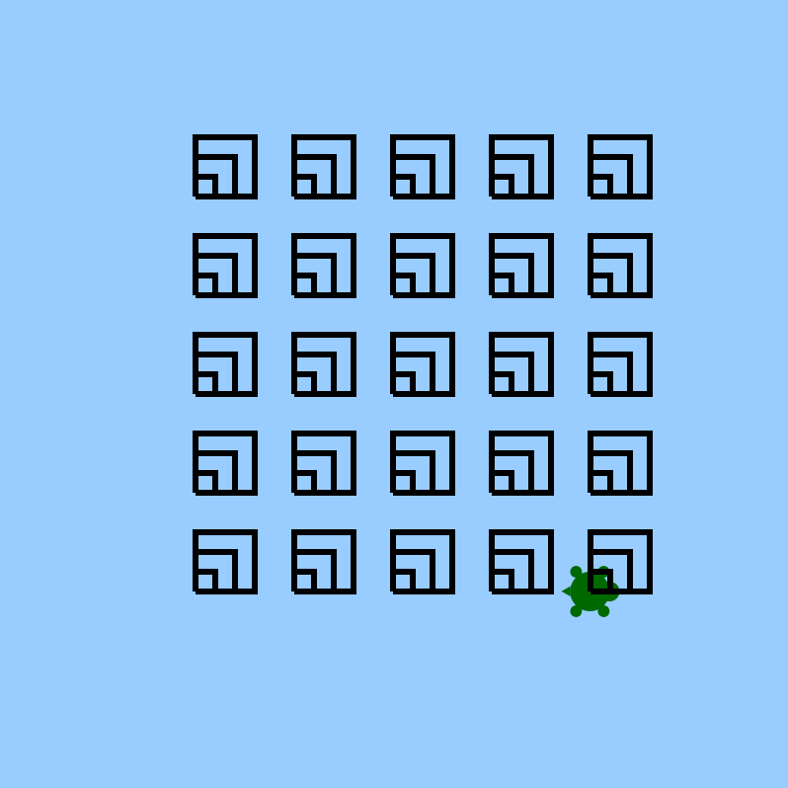
Breakout Session 3
Use Turtle and nested for loops to draw the pattern below.
Open your notebook
Click Link:
4. Breakout Session 3
We just finished this.

Slide 23
Lecture Recap
The general form of a for loops.
Iterable types have indices and items.
For loops always iterate over the items in the iterable variable.
Using range(start, end, step) we can keep track of where we are in a sequence (i.e. index).
for item in iterable:
do something.

Slide 24
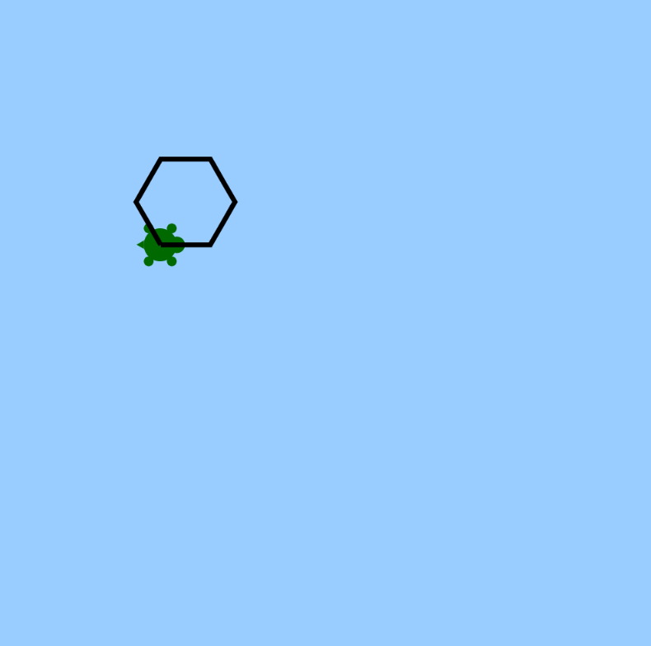
Advanced Turtles
Create a function that draws a polygon at (x, y).
Open your notebook
Click Link:
8. Advanced Turtles
draw_polygon(x, y,
num_sides,
side_length)

Slide 25
more for loops.
Week 6 | Lecture 2 (6.2)

